Slide 1

Integrals Part 2
RCET 0264 Introductory Calculus
Tim Leishman

Slide 2

Integrals Part 2
Integrals:
Also know as Antiderivative.
Purpose is to find the Function of a given differential (or derivative).
Given the known rate of change, $\frac{dy}{dx}$, find the function $y$.
$\int{x^{n}dx}=\frac{x^{n+1}}{n+1}+C$

Slide 3

Integrals Part 2
Integrals Example 1: $\int{x\sqrt[3]{{5x}^{2}−1} dx}$ $\int{x^{n}dx}=\frac{x^{n+1}}{n+1}+C$
$\int{x {({5x}^{2}−1)}^{\frac{1}{3}} dx}$
$\int{10x {({5x}^{2}−1)}^{\frac{1}{3}} dx}$
$\frac{1}{10}\int{10x {({5x}^{2}−1)}^{\frac{1}{3}} dx}=\frac{1}{10}×\frac{{({5x}^{2}−1)}^{\frac{1}{3}+\frac{3}{3}}}{\frac{1}{3}+\frac{3}{3}}+C$
$\frac{1}{10}\int{10x {({5x}^{2}−1)}^{\frac{1}{3}} dx}=\frac{1}{10}×\frac{{({5x}^{2}−1)}^{\frac{4}{3}}}{\frac{4}{3}}+C$
$\frac{1}{10}\int{10x {({5x}^{2}−1)}^{\frac{1}{3}} dx}=\frac{1}{10}×\frac{3{({5x}^{2}−1)}^{\frac{4}{3}}}{4}+C$
$\int{x\sqrt[3]{{5x}^{2}−1} dx}=\frac{3{({5x}^{2}−1)}^{\frac{4}{3}}}{40}+C$

Slide 4

Integrals Part 2
Integrals Example 2: $\int{(3x^{2}+2)({x^{3}+2x)}^{3} dx}$ $\int{x^{n}dx}=\frac{x^{n+1}}{n+1}+C$
$\int{(3x^{2}+2)({x^{3}+2x)}^{3} dx}$
$\int{(3x^{2}+2)({x^{3}+2x)}^{3} dx}$
$\int{(3x^{2}+2)({x^{3}+2x)}^{3} dx}=\frac{{(x^{3}+2x)}^{3+1}}{3+1}+C$
$\int{(3x^{2}+2)({x^{3}+2x)}^{3} dx}=\frac{{(x^{3}+2x)}^{4}}{4}+C$

Slide 5
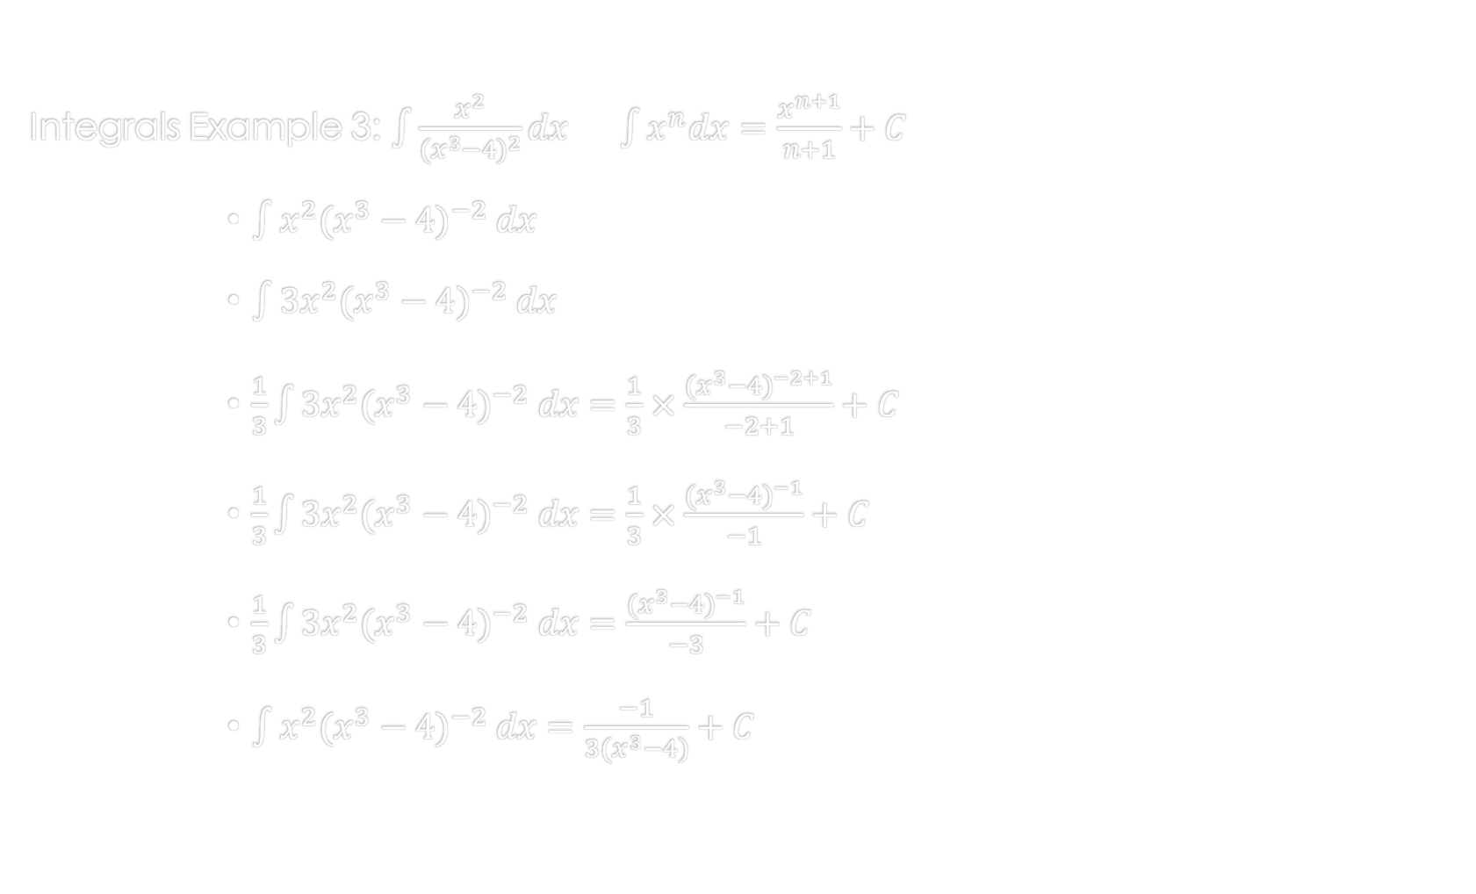
Integrals Part 2
Integrals Example 3: $\int{\frac{x^{2}}{{(x^{3}−4)}^{2}}dx}$ $\int{x^{n}dx}=\frac{x^{n+1}}{n+1}+C$
$\int{x^{2}({x^{3}−4)}^{−2} dx}$
$\int{3x^{2}({x^{3}−4)}^{−2} dx}$
$\frac{1}{3}\int{3x^{2}({x^{3}−4)}^{−2} dx}=\frac{1}{3}×\frac{{(x^{3}−4)}^{−2+1}}{−2+1}+C$
$\frac{1}{3}\int{3x^{2}({x^{3}−4)}^{−2} dx}=\frac{1}{3}×\frac{{(x^{3}−4)}^{−1}}{−1}+C$
$\frac{1}{3}\int{3x^{2}({x^{3}−4)}^{−2} dx}=\frac{{(x^{3}−4)}^{−1}}{−3}+C$
$\int{x^{2}({x^{3}−4)}^{−2} dx}=\frac{−1}{3(x^{3}−4)}+C$

Slide 6
References:
Ewen, D., Gary, J. S., & Trefzger, J. E. (2005). Technical calculus. Upper Saddle River, NJ: Pearson/Prentice Hall.
Richmond, A. E., & Hecht, G. W. (1995). Calculus for electronics. New York: Glence.

